Slide 1
YARN Management

Slide 2
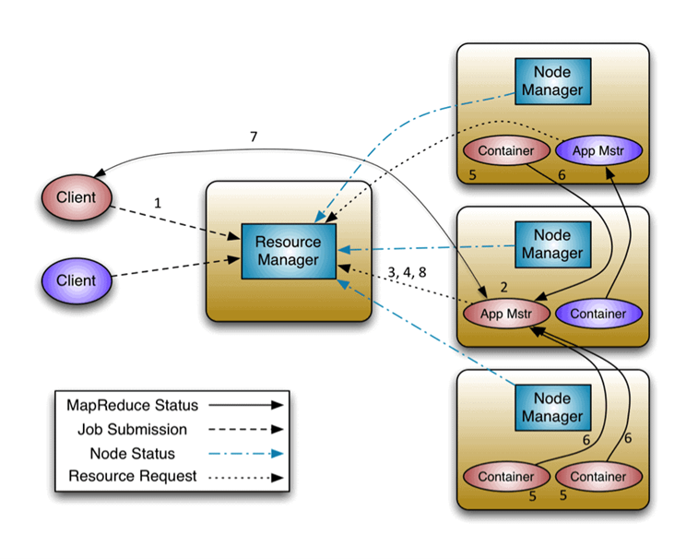
YARN Introduction:
YARN is designed to allow individual applications (via the Application Master) to utilize cluster resources in a shared, Secure and multi-tenant manner.
Also, it remains aware of cluster topology in order to efficiently schedule and optimize dataaccess i.e. reduce data motion for applications to the extent possible

Slide 3
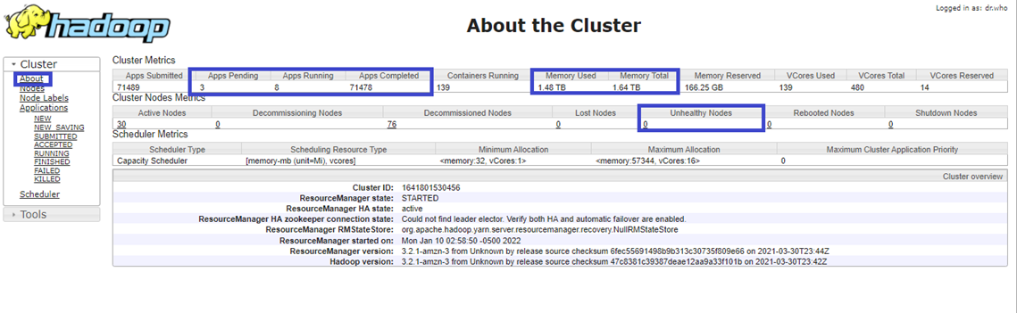
YARN Monitoring:
Open any YARN URL of your choice based on the cluster. For now we are choosing YARN of ingestion cluster
Ingestion URL: http://emr-ing.corp.wabtec.com:8088
Select the options on the left side of the console(left side of the YARN UI) Choose About, it will give the complete information of Apps pending, Apps submitted, Apps running, Apps completed, Unhealthy nodes, lost nodes, Healthy nodes etc.

Slide 4
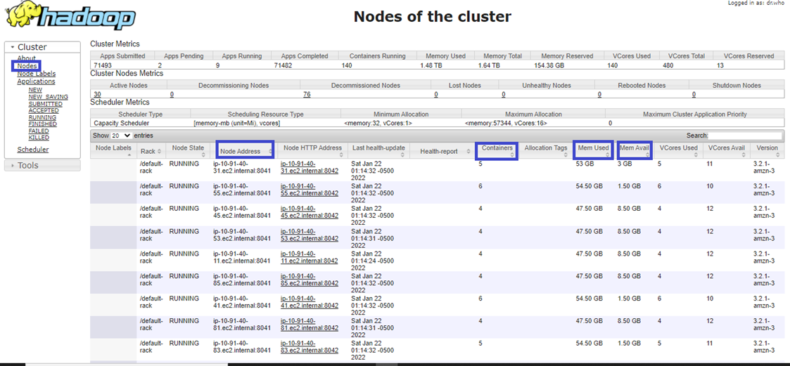
Choose nodes on the left side of the console, Will give complete node address details along with memory available, Consumed and containers assigned to each node.

Slide 5
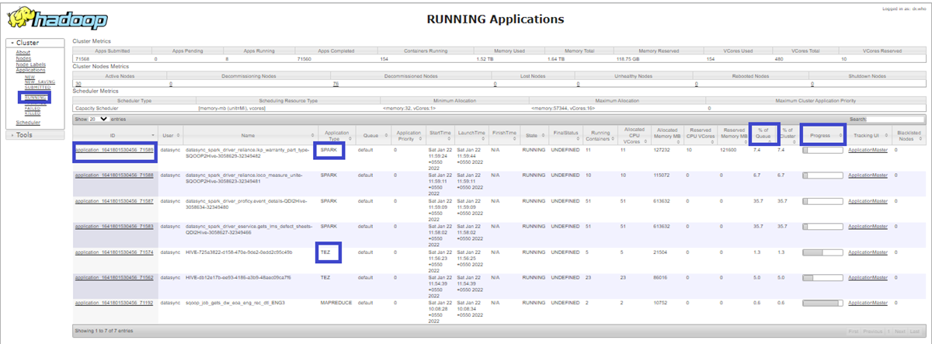
Choose Applications, will give the information like whether the jobs are in submitted, accepted, running, finished, failed and killed.
Ex: Select running, will give running job information along with queue utilization, type of job (Spark/MapReduce/Tez) and progress of the job

Slide 6
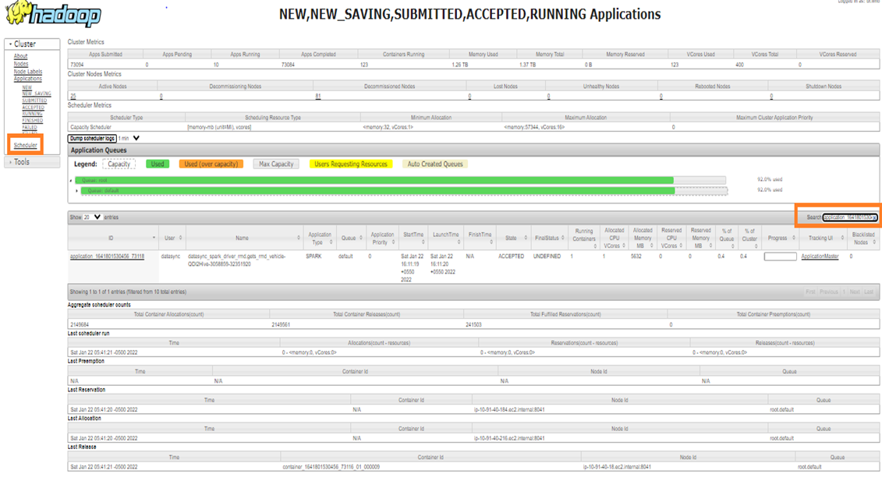
Choose Scheduler on the left side of the console, will gives the information regarding queue capacity and utilization. On the left side of the console, With application id we can search for the job information.

Slide 7
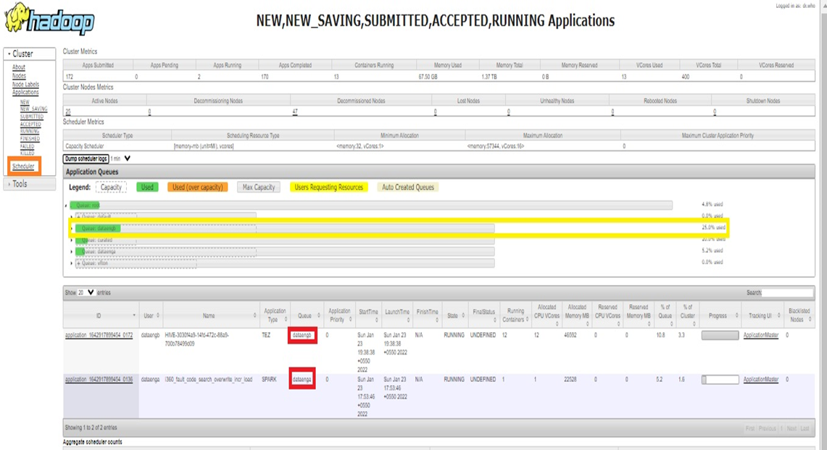
Choose Scheduler on the left side of the console, will gives the information regarding queue capacity, on which queue Job running and utilization.

